Slide 1

Boolean Algebra & Logic Gates

Slide 2
Objectives
Understand the relationship between Boolean logic and digital computer circuits.
Learn how to design simple logic circuits.
Understand how digital circuits work together to form complex computer systems.

Slide 3

Boolean Algebra
Boolean algebra is a mathematical system for the manipulation of variables that can have one of two values.
  In formal logic, these values are “true” and “false.”
  In digital systems, these values are “on” and “off,” 1 and 0, or “high” and “low.”
Boolean expressions are created by performing operations on Boolean variables.
  Common Boolean operators include AND, OR, and NOT.

Slide 4
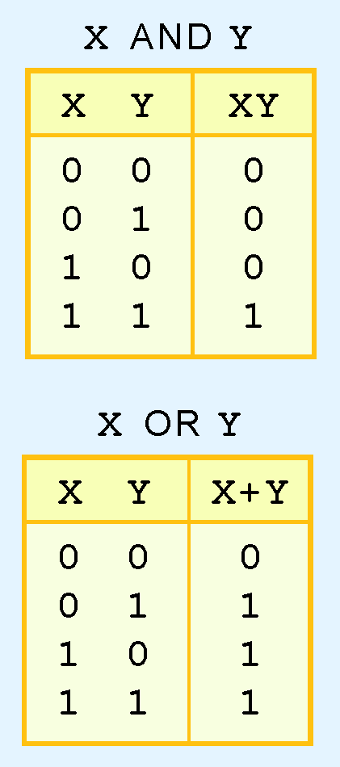
Boolean Algebra
A Boolean operator can be completely described using a truth table.
The truth table for the Boolean operators AND and OR are shown at the right.
The AND operator is also known as a Boolean product. The OR operator is the Boolean sum.

Slide 5
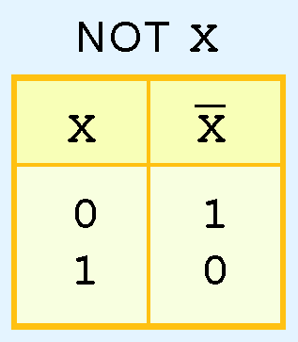
Boolean Algebra
The truth table for the Boolean NOT operator is shown at the right.
The NOT operation is most often designated by an overbar. It is sometimes indicated by a prime mark ( ‘ ) or an “elbow” (¬).

Slide 6
Boolean Algebra
A Boolean function has:
  At least one Boolean variable,
  At least one Boolean operator, and
  At least one input from the set {0,1}.
It produces an output that is also a member of the set {0,1}.
Now you know why the binary numbering system is so handy in digital systems.

Slide 7
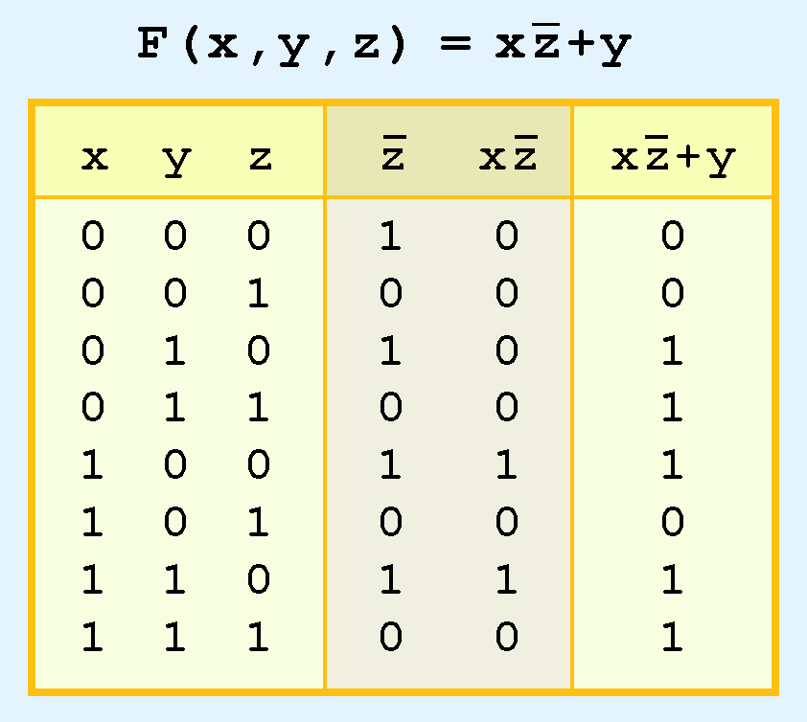
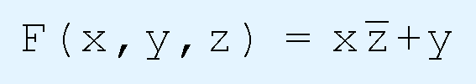
Boolean Algebra
The truth table for the Boolean function:
is shown at the right.
To make evaluation of the Boolean function easier, the truth table contains extra (shaded) columns to hold evaluations of subparts of the function.

Slide 8
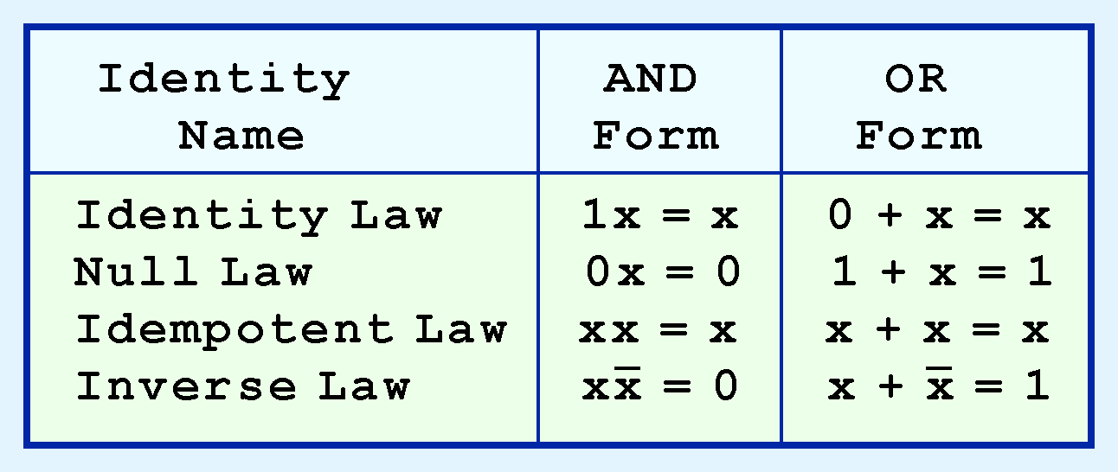
Boolean Algebra
Most Boolean identities have an AND (product) form as well as an OR (sum) form. We give our identities using both forms. Our first group is rather intuitive:

Slide 9
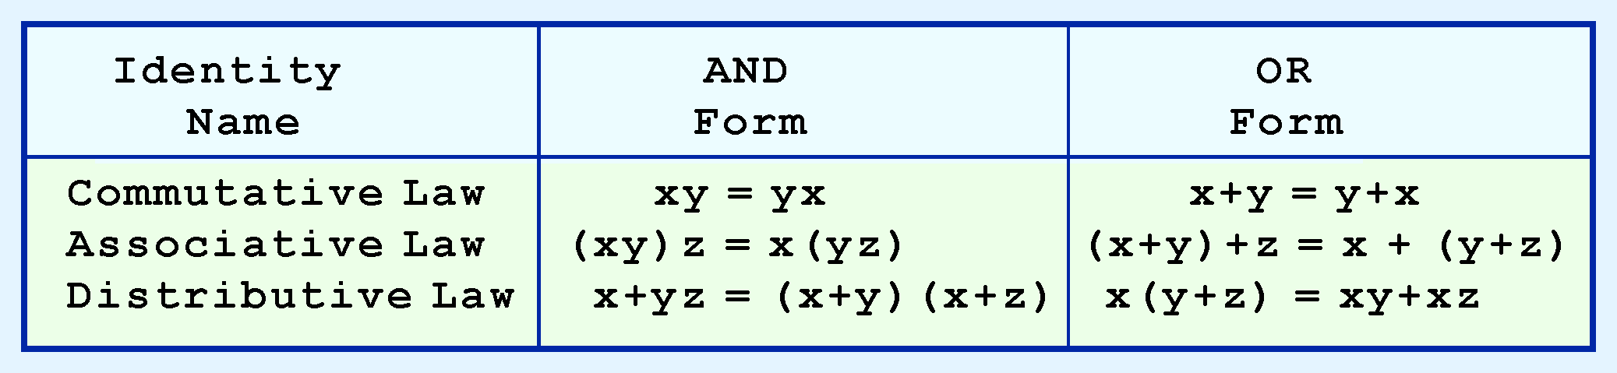
Boolean Algebra
Our second group of Boolean identities should be familiar to you from your study of algebra:

Slide 10
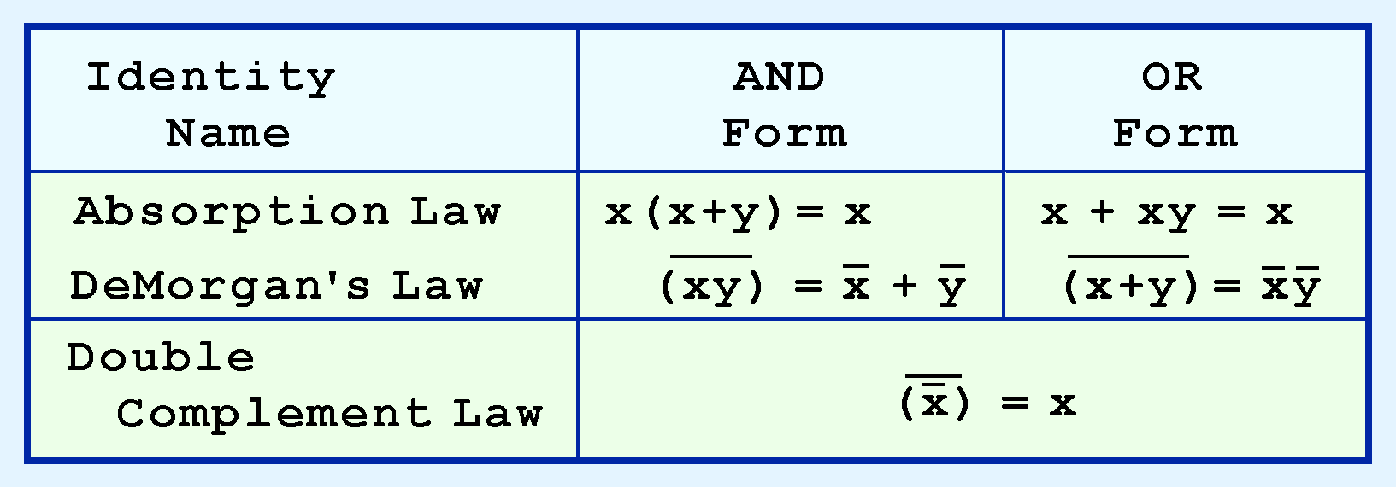
Boolean Algebra
Our last group of Boolean identities are perhaps the most useful.
If you have studied set theory or formal logic, these laws are also familiar to you.

Slide 11
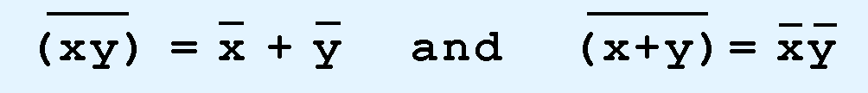
Boolean Algebra
Sometimes it is more economical to build a circuit using the complement of a function (and complementing its result) than it is to implement the function directly.
DeMorgan’s law provides an easy way of finding the complement of a Boolean function.
Recall DeMorgan’s law states:

Slide 12
Logic Gates
We have looked at Boolean functions in abstract terms.
In this section, we see that Boolean functions are implemented in digital computer circuits called gates.
A gate is an electronic device that produces a result based on two or more input values.
  In reality, gates consist of one to six transistors, but digital designers think of them as a single unit.
  Integrated circuits contain collections of gates suited to a particular purpose.

Slide 13
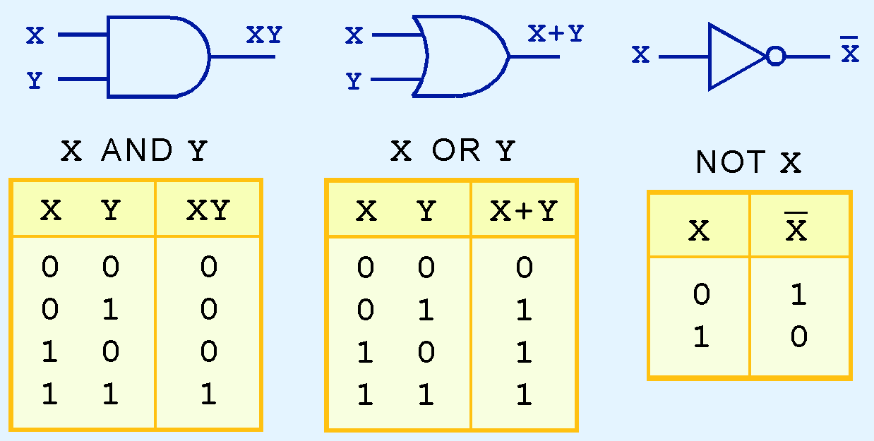
Logic Gates
The three simplest gates are the AND, OR, and NOT gates.
They correspond directly to their respective Boolean operations, as you can see by their truth tables.

Slide 14
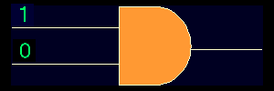

Logic Gates
AND GATE
1 AND 0 = 0
OR GATE
1 OR 0 = 1

Slide 15
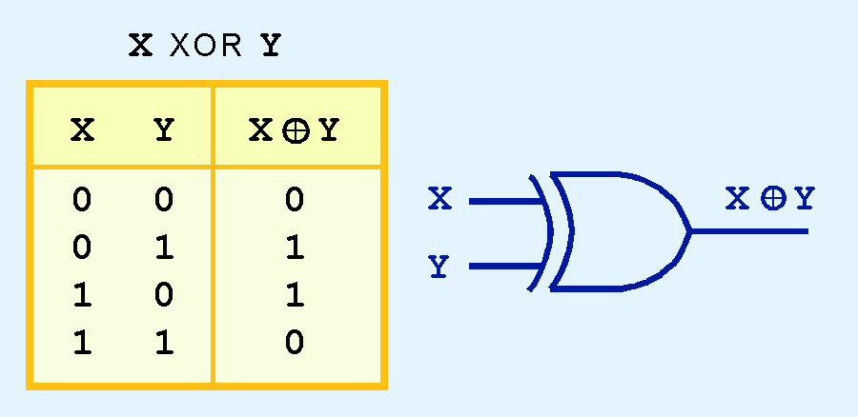
Logic Gates
Another very useful gate is the exclusive OR (XOR) gate.
The output of the XOR operation is true only when the values of the inputs differ.
Note the special symbol ⊕ for the XOR operation.

Slide 16


Logic Gates
XOR GATE
1 XOR 0 = 1
XOR GATE
1 XOR 1 = 0

Slide 17
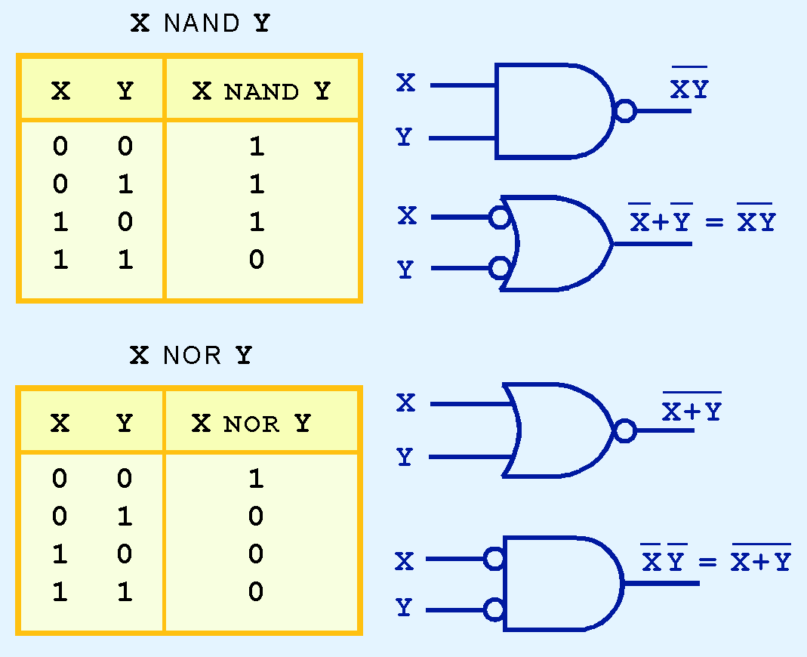
Logic Gates
NAND and NOR are two very important gates. Their symbols and truth tables are shown at the right.

Slide 18
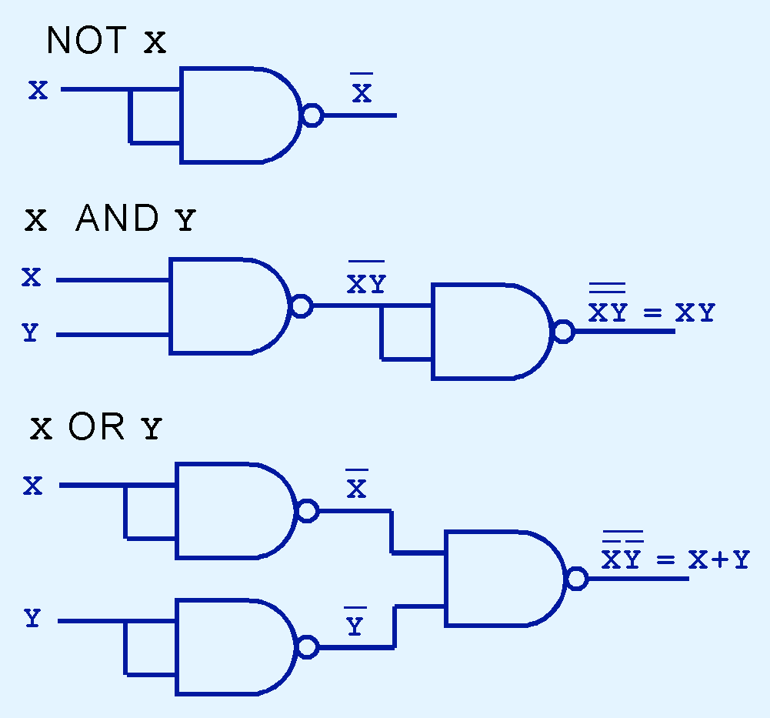
Logic Gates
NAND and NOR are known as universal gates because they are inexpensive to manufacture and any Boolean function can be constructed using only NAND or only NOR gates.

Slide 19
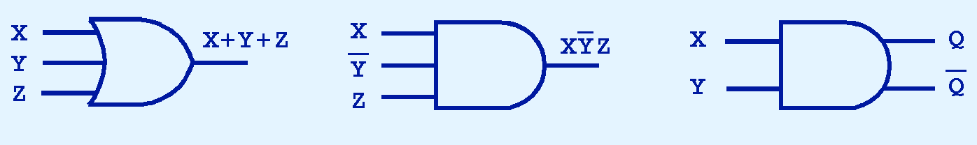
Logic Gates
Gates can have multiple inputs and more than one output.
  A second output can be provided for the complement of the operation.
  We’ll see more of this later.

Slide 20

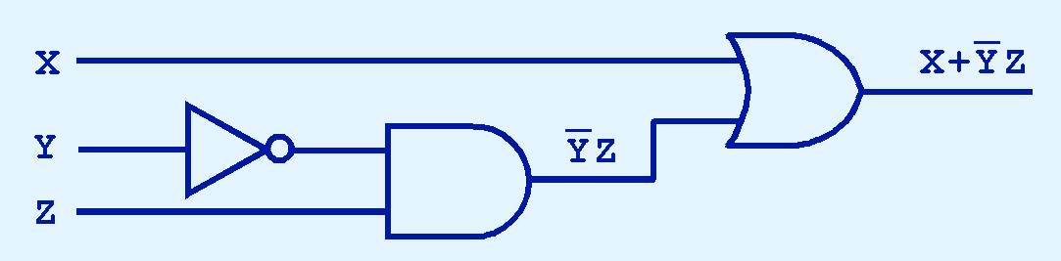
Digital Components
The main thing to remember is that combinations of gates implement Boolean functions.
The circuit below implements the Boolean function:
We simplify our Boolean expressions so that we can create simpler circuits.

Slide 21
Combinational Circuits
We have designed a circuit that implements the Boolean function:
This circuit is an example of a combinational logic circuit.
Combinational logic circuits produce a specified output (almost) at the instant when input values are applied.
  In a later section, we will explore circuits where this is not the case.

Slide 22
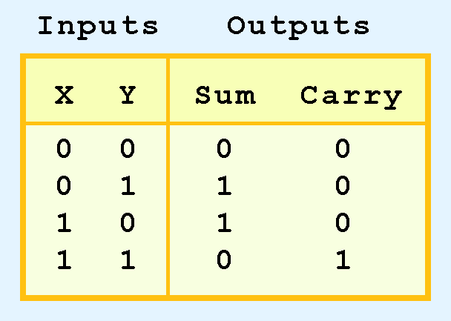
Combinational Circuits
Combinational logic circuits give us many useful devices.
One of the simplest is the half adder, which finds the sum of two bits.
We can gain some insight as to the construction of a half adder by looking at its truth table, shown at the right.

Slide 23
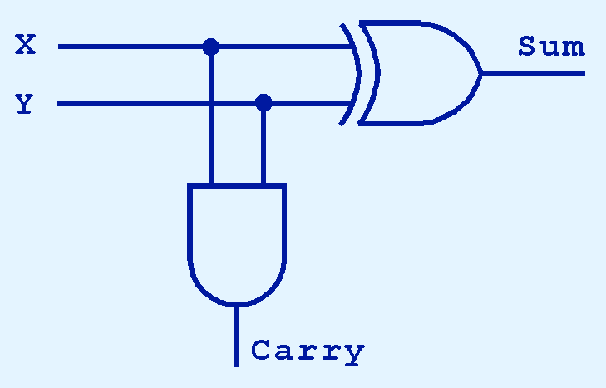
Combinational Circuits
As we see, the sum can be found using the XOR operation and the carry using the AND operation.

Slide 24
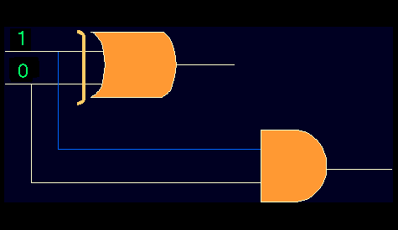
Combinational Circuits
S
C
Half Adder

Slide 25
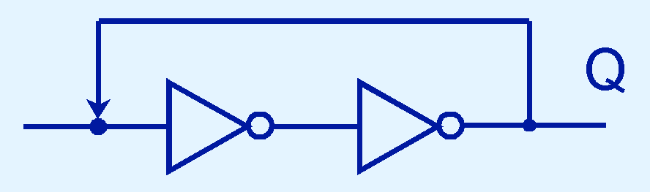
Sequential Circuits
To retain their state values, sequential circuits rely on feedback.
Feedback in digital circuits occurs when an output is looped back to the input.
A simple example of this concept is shown below.
  If Q is 0 it will always be 0, if it is 1, it will always be 1. Why?

Slide 26
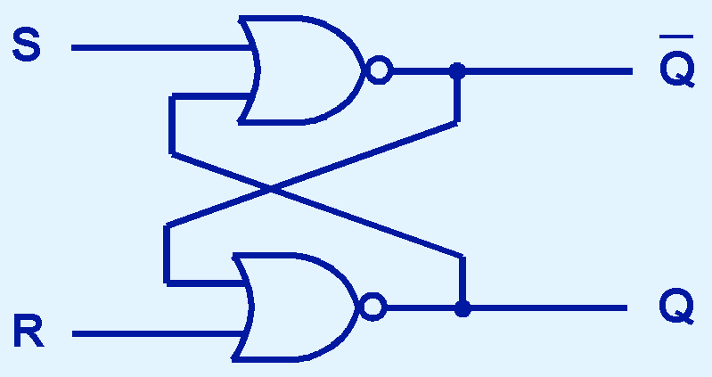
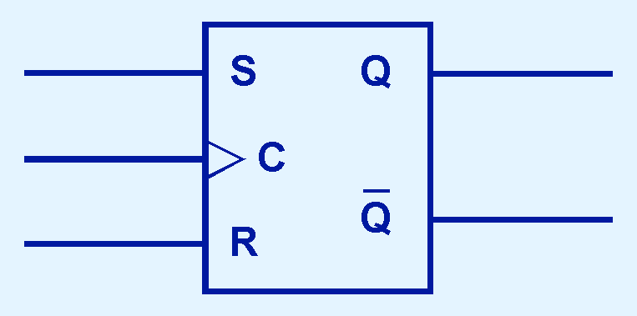
Sequential Circuits
You can see how feedback works by examining the most basic sequential logic components, the SR flip-flop.
  The “SR” stands for set/reset.
The internals of an SR flip-flop are shown below, along with its block diagram.

Slide 27
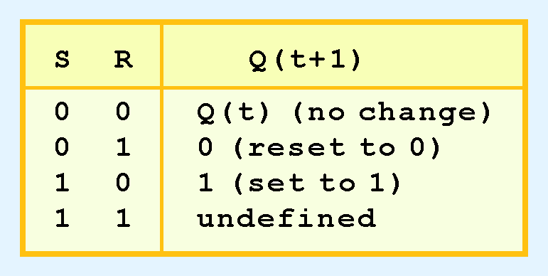
Sequential Circuits
The behavior of an SR flip-flop is described by a characteristic table.
Q(t) means the value of the output at time t. Q(t+1) is the value of Q after the next clock pulse.

Slide 28
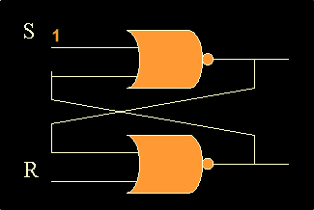
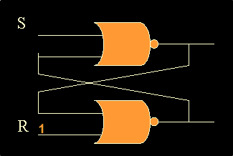
Sequential Circuits
SR flip-flop
SET
SR flip-flop
RESET

Slide 29
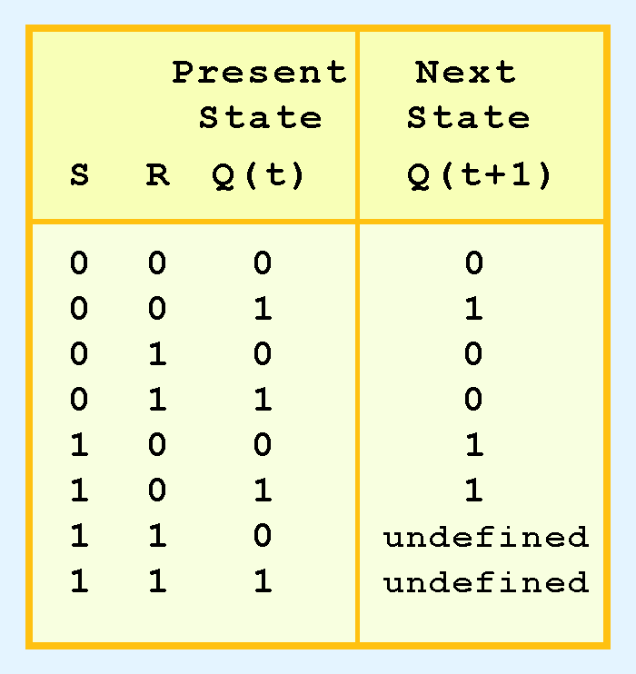
Sequential Circuits
The SR flip-flop actually has three inputs: S, R, and its current output, Q.
Thus, we can construct a truth table for this circuit, as shown at the right.
Notice the two undefined values. When both S and R are 1, the SR flip-flop is unstable.

Slide 30
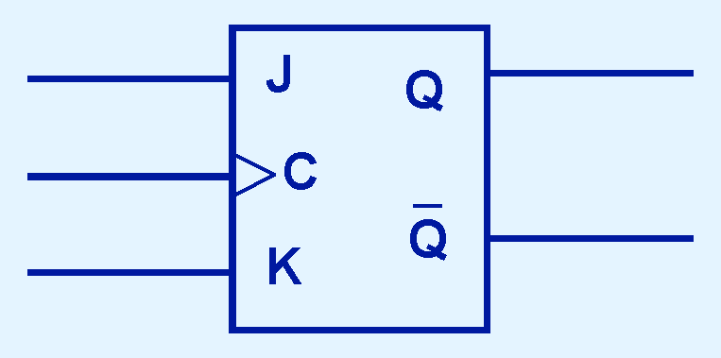
Sequential Circuits
If we can be sure that the inputs to an SR flip-flop will never both be 1, we will never have an unstable circuit. This may not always be the case.
The SR flip-flop can be modified to provide a stable state when both inputs are 1.
• This modified flip-flop is called a JK flip-flop, shown at the right.
- The “JK” is in honor of
Jack Kilby.

Slide 31
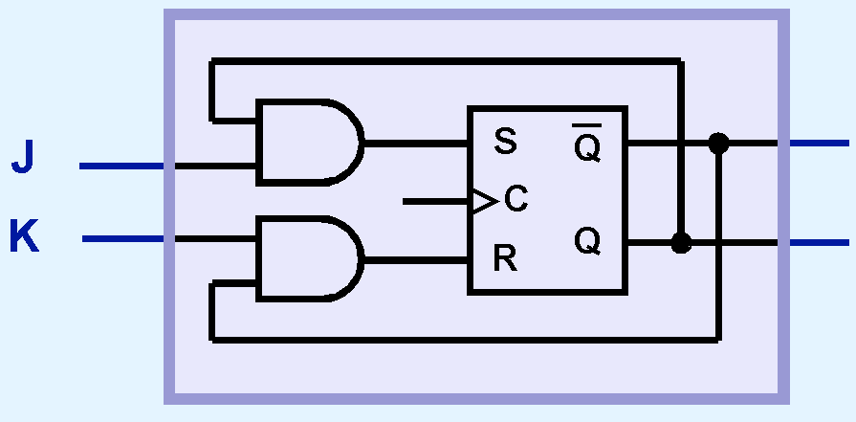
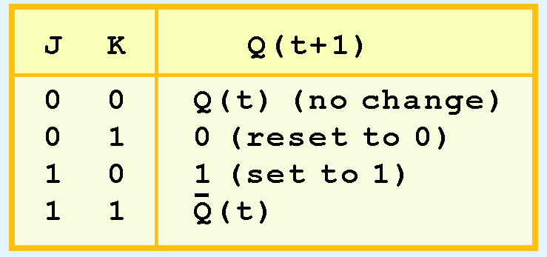
Sequential Circuits
At the right, we see how an SR flip-flop can be modified to create a JK flip-flop.
The characteristic table indicates that the flip-flop is stable for all inputs.

Slide 32
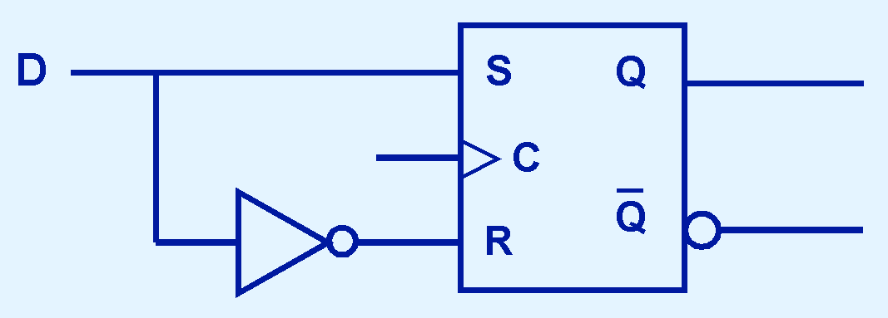
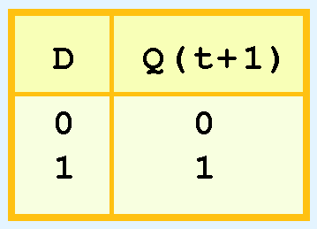
Sequential Circuits
Another modification of the SR flip-flop is the D flip-flop, shown below with its characteristic table.
You will notice that the output of the flip-flop remains the same during subsequent clock pulses. The output changes only when the value of D changes.

Slide 33
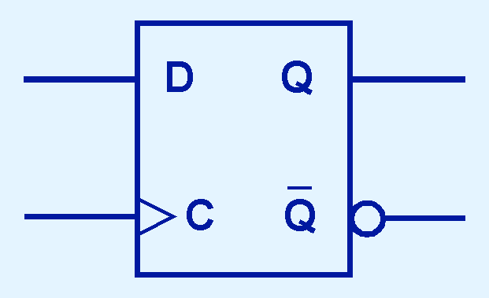
Sequential Circuits
The D flip-flop is the fundamental circuit of computer memory.
  D flip-flops are usually illustrated using the block diagram shown below.
The next slide shows how these circuits are combined to create a register.

Slide 34
Conclusion
Computers are implementations of Boolean logic.
Boolean functions are completely described by truth tables.
Logic gates are small circuits that implement Boolean operators.
The basic gates are AND, OR, and NOT.
  The XOR gate is very useful in parity checkers and adders.
The “universal gates” are NOR, and NAND.

Slide 35
Conclusion
Computer circuits consist of combinational logic circuits and sequential logic circuits.
Combinational circuits produce outputs (almost) immediately when their inputs change.
Sequential circuits require clocks to control their changes of state.
The basic sequential circuit unit is the flip-flop: The behaviors of the SR, JK, and D flip-flops are the most important to know.

Slide 36
End

